Slide 1

The Profound Impact of Music on Our Lives
Presented by Tchinda Feze Cedrick and Feuzet Kitio Russelle

Slide 2
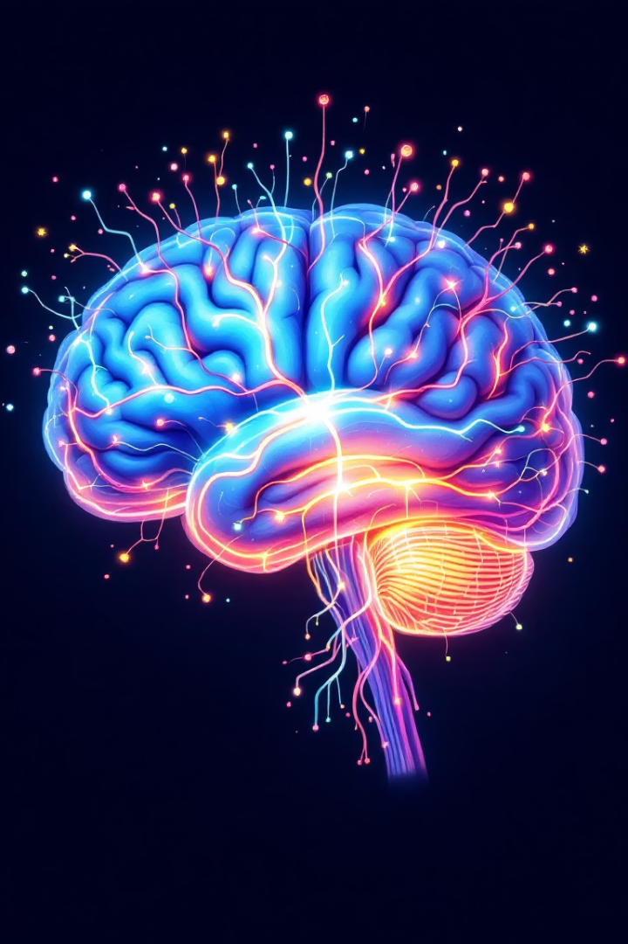




The science behind musical response
Sound Reception
Sound waves enter the ear canal and vibrate the eardrum.
Neural Processing
The auditory cortex decodes these vibrations into recognizable sounds.
Emotional Response
The limbic system creates emotional reactions to music.
Physical Effects
Heart rate, breathing, and hormone levels change in response.

Slide 3





Emotional Resonance
Joy & Excitement
Upbeat tempos and major keys trigger dopamine release, creating feelings of pleasure.
Sadness & Reflection
Minor keys and slow tempos can induce melancholy, helping process grief.
Calm & Relaxation
Gentle rhythms reduce cortisol levels, lowering stress and anxiety.
Motivation & Energy
Driving beats increase heart rate and prepare the body for action.

Slide 4








Music as Emotional Therapy
Trauma
Anxiety
Music provides safe emotional processing.
Slow-tempo music lowers cortisol levels.
Accesses nonverbal memories
Depression
Regulates breathing
Grief
Music therapy reduces depressive symptoms by 25%.
Creates mental space
Builds new associations
Emotional songs validate difficult feelings.
Increases motivation
Facilitates expression
Provides emotional release
Creates community

Slide 5

Music Therapy Applications
45%
Anxiety Reduction
Average decrease in anxiety scores after music therapy sessions
67%
Depression Recovery
Patients showing improvement with combined standard and music therapy
38%
Dementia Care
Increase in positive social interactions among patients
72%
Rehabilitation
Stroke patients showing improved motor function with rhythmic therapy

Slide 6
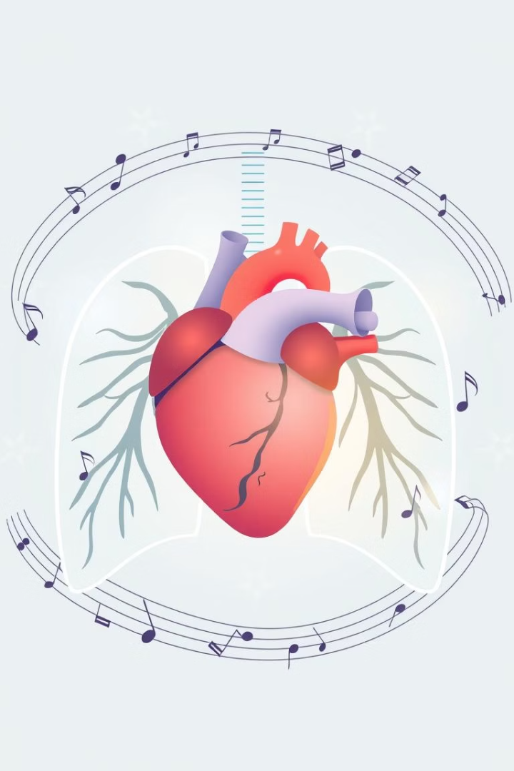
Music's Impact on the Body
Heart rate and breathing
Blood pressure reduction
Music slows and steadies the heart and breathing rates, promoting calmness.
Listening to soothing music lowers blood pressure, reducing stress.
Pain management
Music can decrease pain perception and ease discomfort during recovery.

Slide 7
Music and Sleep Quality
Improved sleep
Exercise performance
Music helps relax the mind, making it easier to fall asleep.
Upbeat music boosts motivation and endurance during workouts.
Reduces anxiety
Promotes deeper sleep stages
Enhances overall restfulness
Increases stamina
Improves focus
Masks fatigue

Slide 8

Music as a Social Connector
Cross-cultural bonds
Building relationships
Music bridges cultural divides, fostering mutual understanding and respect.
Shared music experiences strengthen friendships and family ties.
Community engagement
Music events create a sense of belonging and collective joy.

Slide 9




Key Takeaways & Next Steps
Physical benefits
Performance boost
Social connection
Music positively affects heart, pain, and sleep health.
Exercise outcomes improve with the right musical accompaniment.
Music unites people beyond language and culture.

